Slide 1
Fourth Quarter Fiscal Year 2014 Results

Slide 3
Agenda

Slide 4
Q4 Financial Summary

Slide 5
Impact of Acquired NDS Business

Slide 6
Q4 Results vs Guidance

Slide 7
Quarterly Highlights Cloud adoption drives strong Q4 results

Slide 8
Devices & Consumer

Slide 9
D&C Licensing Developed markets driving growth in Windows and Office

Slide 10
Computing and Gaming Hardware Results driven by higher Surface and Xbox platform revenue

Slide 11
Phone Hardware New segment to report results of acquired NDS business post 4/25/2014 deal close

Slide 12
D&C Other Results driven by search advertising and Office 365 Consumer

Slide 13
Commercial

Slide 14
Commercial Segments Customers adopting hybrid cloud solutions

Slide 15
Other Financial Highlights

Slide 16
Appendix

Slide 17
Reconciliation of GAAP and non-GAAP Financial Measures

Slide 18
Noted Items Definitions

Slide 19
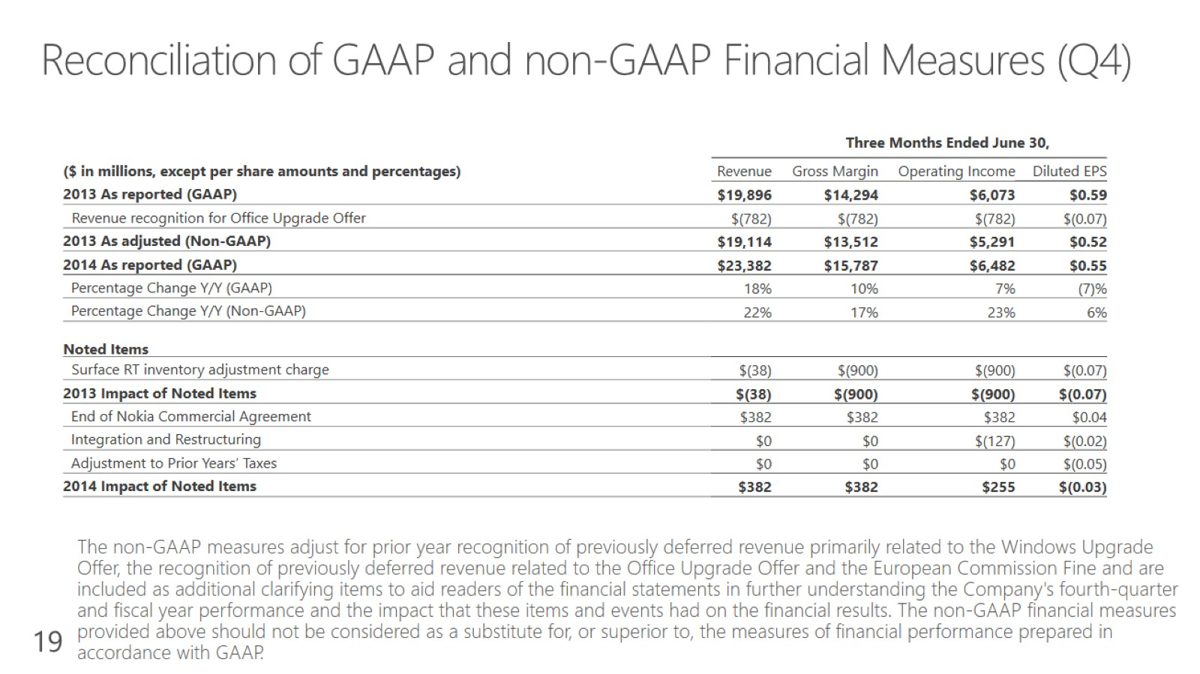
Reconciliation of GAAP and non-GAAP Financial Measures (Q4)

Slide 20
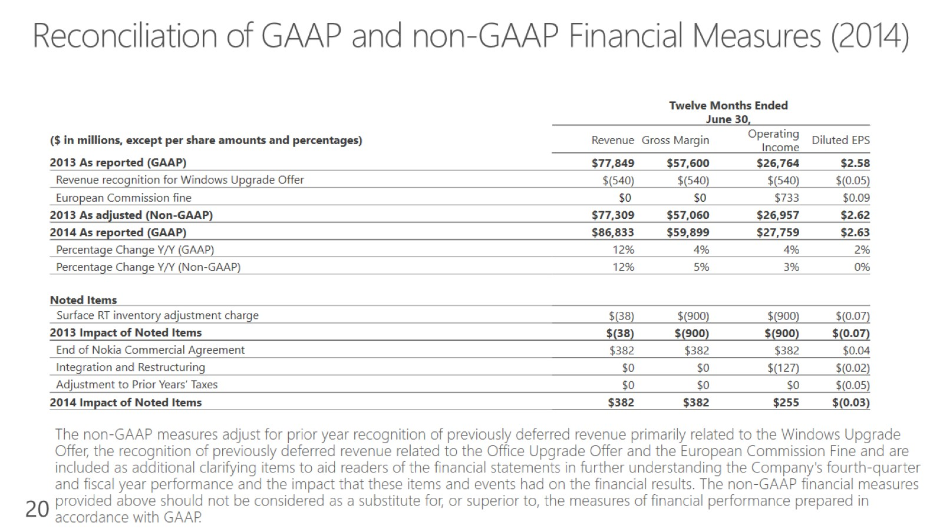
Reconciliation of GAAP and non-GAAP Financial Measures (2014)

