Slide 1
First Quarter Fiscal Year 2015 Results

Slide 3
Agenda

Slide 4
Q1 Financial Summary

Slide 5
Quarterly Highlights Microsoft Cloud Strength and Hardware Progress Drive Record First-Quarter Revenue

Slide 6
Devices & Consumer

Slide 7
D&C Licensing New licensing programs helping improve the health of the Windows ecosystem

Slide 8
Computing and Gaming Hardware Results driven by higher Surface and Xbox console revenue

Slide 9
Phone Hardware Continued focus on execution

Slide 10
D&C Other Results driven by higher search advertising and Office 365 Consumer revenue

Slide 11
Commercial

Slide 12
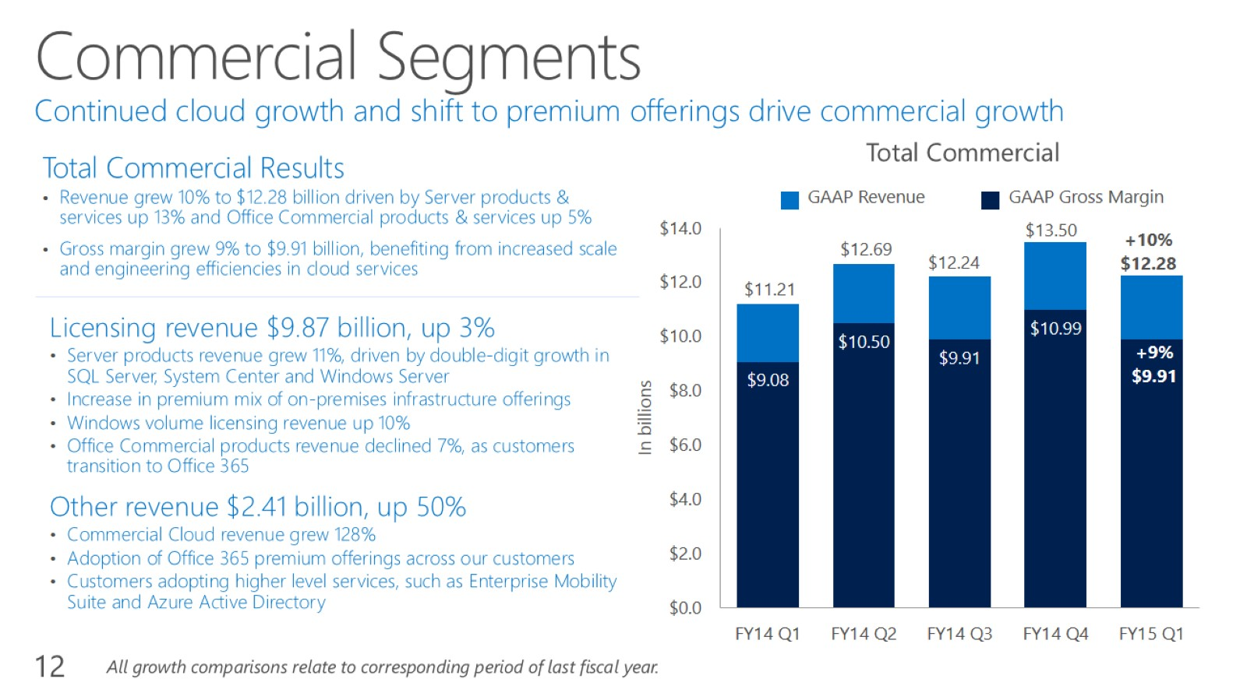
Commercial Segments Continued cloud growth and shift to premium offerings drive commercial growth

Slide 13
Other Financial Highlights

